Slide 1
IBM University Engagement Project Submission
“Exploring the Power of Agentic AI with IBM Granite and LangFlow”

Slide 2

Project Tile – AI Legal Aid Multi-Agent System
Domain of Project – Legal Technology
Student Name | Recent Passport Photo | Email ID | Mobile number [WhatsApp]
Dr Pavana H |  | pavana62@gmail.com | 9916741952

Slide 3
Problem Statement -
Problem Statement : AI Legal Aid Multi-Agent System
The Challenge
Access to legal advice is often expensive, time-consuming, and complex. Individuals and small businesses struggle to understand contracts, rights, and compliance due to scattered resources and legal jargon. Traditional legal aid systems are limited by availability of experts and lack of real-time support.
The Objective
Build an AI-powered Multi-Agent Legal Aid System that can:
1.Legal Information Retrieval (RAG) – Use Retrieval-Augmented Generation to extract and summarize relevant laws, precedents, and compliance rules from large legal corpora.
2.Document Parsing & Analysis – Automatically analyze contracts, policies, and notices to highlight key clauses, obligations, and potential risks.
3.Conversational Legal Assistant – Provide empathetic, easy-to-understand explanations of legal concepts through natural dialogue (with disclaimers: not a substitute for a lawyer).
4.Specialized Multi-Agents –
•Contract Reviewer Agent: Flag risks and inconsistencies.
•Compliance Checker Agent: Verify adherence to rules/regulations.
•Q&A RAG Agent: Answer user-specific queries.
•Case Research Agent: Fetch relevant judgments or case summaries.

Slide 4
Proposed Solution -
Step 1: User Input
User enters a legal query or uploads a legal document (contract, policy, notice, etc.) through the dashboard.
Step 2: Query & Document Processing
The system identifies the user's intent and extracts text from uploaded documents for analysis.
Step 3: RAG-Based Legal Information Retrieval
The Q&A RAG Agent retrieves relevant laws, regulations, precedents, and compliance rules from legal databases.
Generates accurate, source-based legal information.
Step 4: Document Analysis
The Document Parsing Agent extracts key clauses, obligations, deadlines, penalties, and important terms.
Identifies potential legal risks and inconsistencies.
Step 5: Specialized Multi-Agent Processing
Contract Reviewer Agent: Reviews contracts and flags risky or missing clauses.
Compliance Checker Agent: Verifies compliance with applicable laws and regulations.
Case Research Agent: Retrieves relevant judgments and case summaries.
Q&A RAG Agent: Answers user-specific legal questions using retrieved legal knowledge.
red format.

Slide 5
Proposed Solution -
Step 7: Conversational Legal Assistance
The AI assistant explains legal findings in simple, easy-to-understand language.
Displays a disclaimer that the advice is for informational purposes and not a substitute for a lawyer.
Step 8: Dashboard & Recommendations
The dashboard presents:
Legal summary
Document highlights
Risk assessment
Compliance status
Relevant case references
Actionable recommendations and next steps
Step 9: Final Output
The user receives a comprehensive legal report with document analysis, cited legal sources, compliance results, and practical guidance in a clear and structured format.

Slide 6
Technology Used
IBM Grainte model - for eg – ibm-granite-3-2-8b – For natural language understanding, reasoning, and personalization
IBM Cloud – It provides the infrastructure to build, deploy, and scale the Nutrition Agent efficiently. IBM Cloud enables a reliable, secure, and scalable environment for deploying the Nutrition Agent.
RAG– RAG to fetch real data first, then generate intelligent answers, making the Nutrition Agent more trustworthy and effective.
IBM Watsonx.ai - For model deployment, embeddings, and AI governance

Slide 7

Role of Agentic AI in the solution
Role of Agentic AI Legal Aid Multi-Agent System
Agentic AI acts as the central coordinator of an AI Legal Aid Multi-Agent System, managing specialized AI agents to solve legal queries efficiently. It analyzes user requests, assigns tasks such as legal research, document analysis, risk assessment, and recommendation generation to the appropriate agents, and combines their outputs into a clear response. It also automates legal workflows, retrieves relevant legal information, personalizes assistance based on the user's situation, and monitors ongoing tasks. For complex or high-risk cases, it can escalate the matter to human legal professionals. Overall, Agentic AI improves the accuracy, efficiency, scalability, and accessibility of legal aid services.

Slide 8
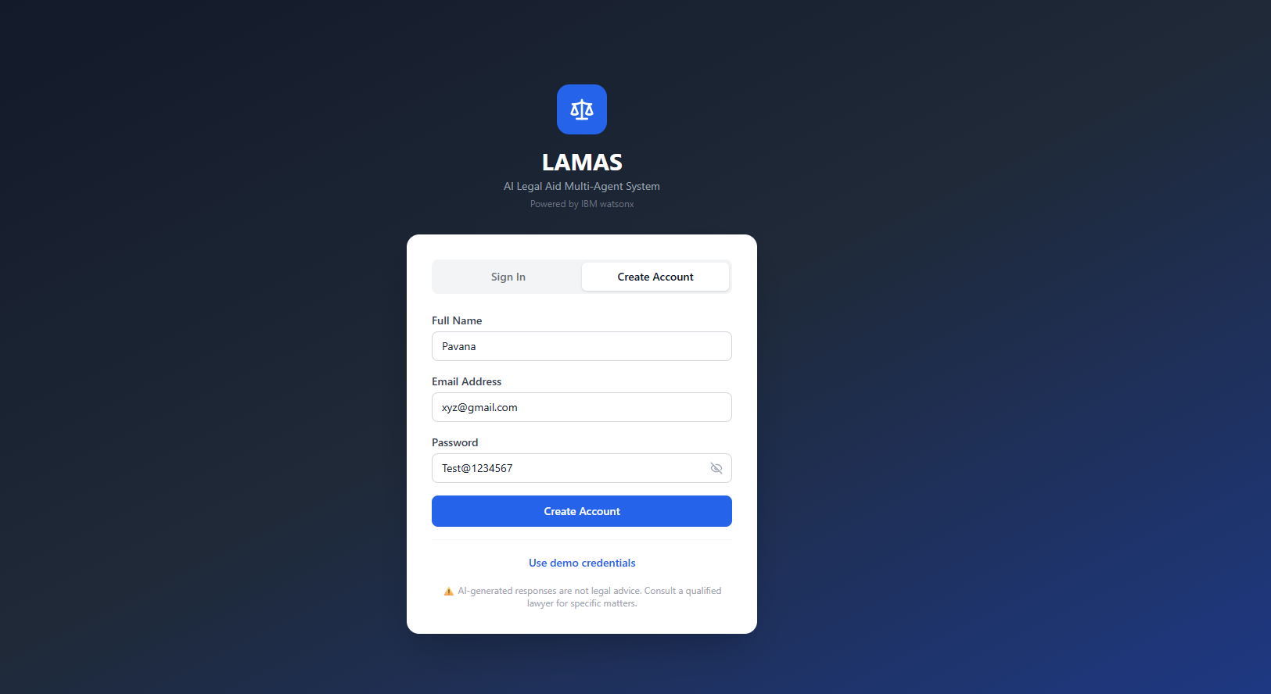
Project Output Screen Shot
·
·
·

Slide 9
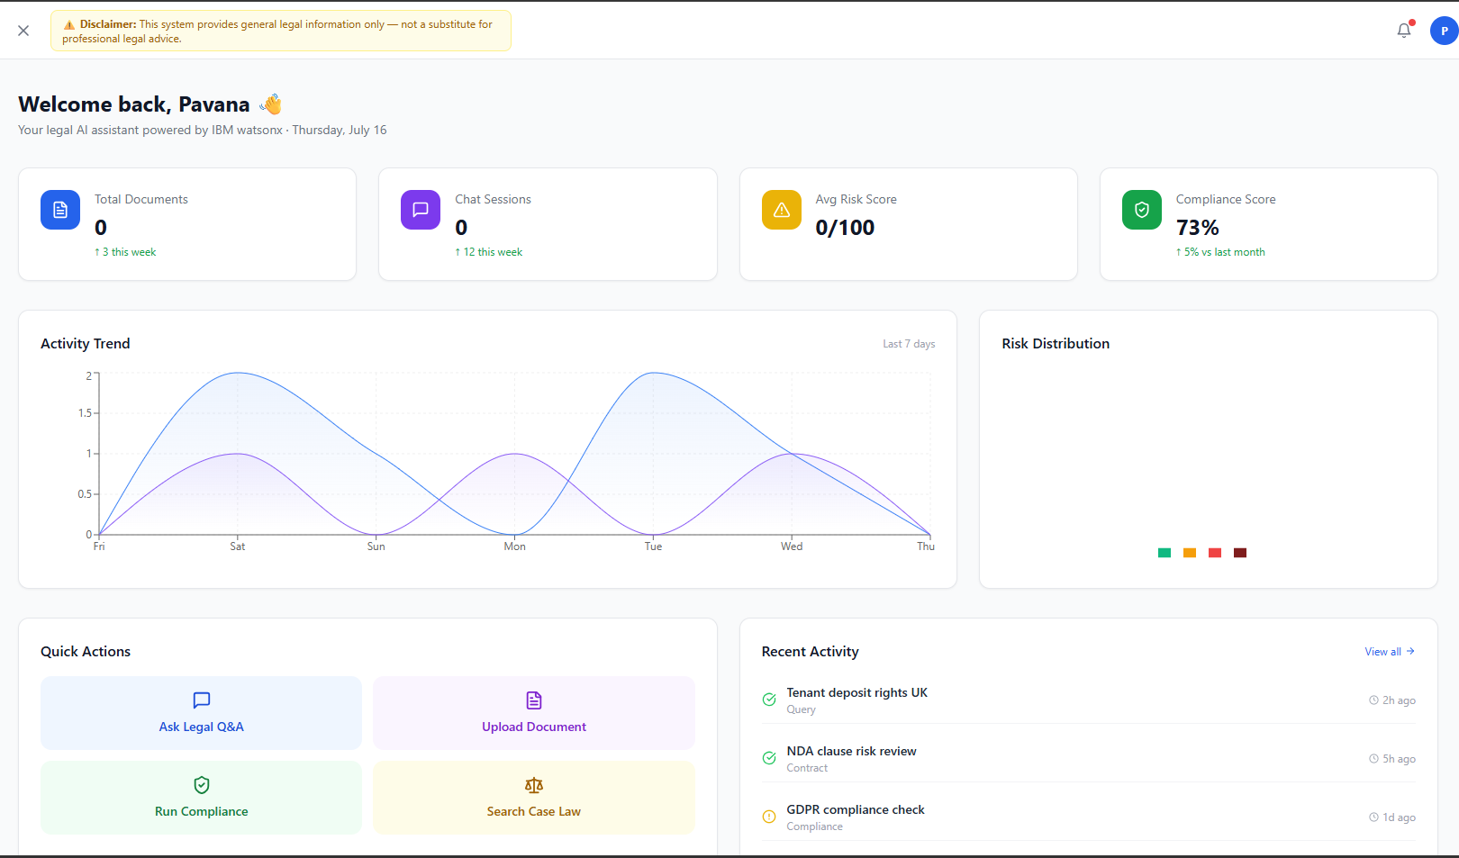
·
·
·

Slide 10
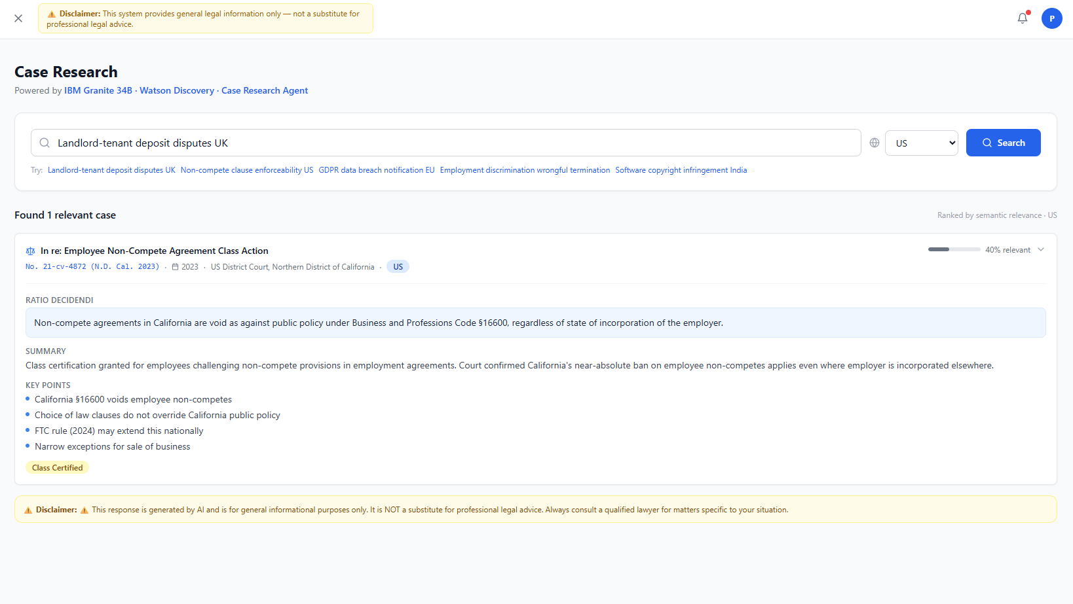
·
·
·

Slide 11
Novelty and Uniqueness
The proposed Nutrition Agent stands out by combining Agentic AI, RAG, and personalization into a single intelligent system.
Multi-Agent Collaboration: Specialized AI agents work together to analyze legal queries and verify results.
RAG-Based Legal Retrieval: Retrieves accurate legal information with supporting laws, regulations, and case references.
Legal Risk Scoring: Assesses contracts and legal situations with clear risk levels and explanations.
Plain-Language Explanations: Converts complex legal terminology into simple, user-friendly language.
What-If Scenario Analysis: Simulates different legal outcomes based on changes in contracts or situations.
Jurisdiction-Aware Guidance: Provides recommendations based on applicable local laws and regulations.
Explainable AI: Shows how each AI agent contributed to the final recommendation.
Interactive Dashboard: Presents document highlights, risk assessments, case insights, and actionable recommendations.
Human Lawyer Escalation: Refers complex or high-risk cases to legal professionals with a summarized case report.
Accessible and Transparent: Makes legal assistance faster, more reliable, and easier for individuals and small businesses to understand.

Slide 12
Git Hub Link
https://github.com/drpavana2025-ctrl/IBM_project
·
·
·

Slide 13
Future Scope
Integrate with government legal portals and court databases for real-time legal information.
Expand support to multiple jurisdictions and regional languages.
Introduce voice-based legal assistance for improved accessibility.
Enable predictive legal analytics for case outcome and risk estimation.
Automate legal document generation and compliance reporting.
Provide real-time updates on legal changes and regulations.
Strengthen collaboration between AI agents and legal professionals.
Develop a mobile application for on-the-go legal assistance.
Enhance security and privacy for sensitive legal data.
Add court case tracking and e-signature integration for end-to-end legal support.
·
·

Slide 14
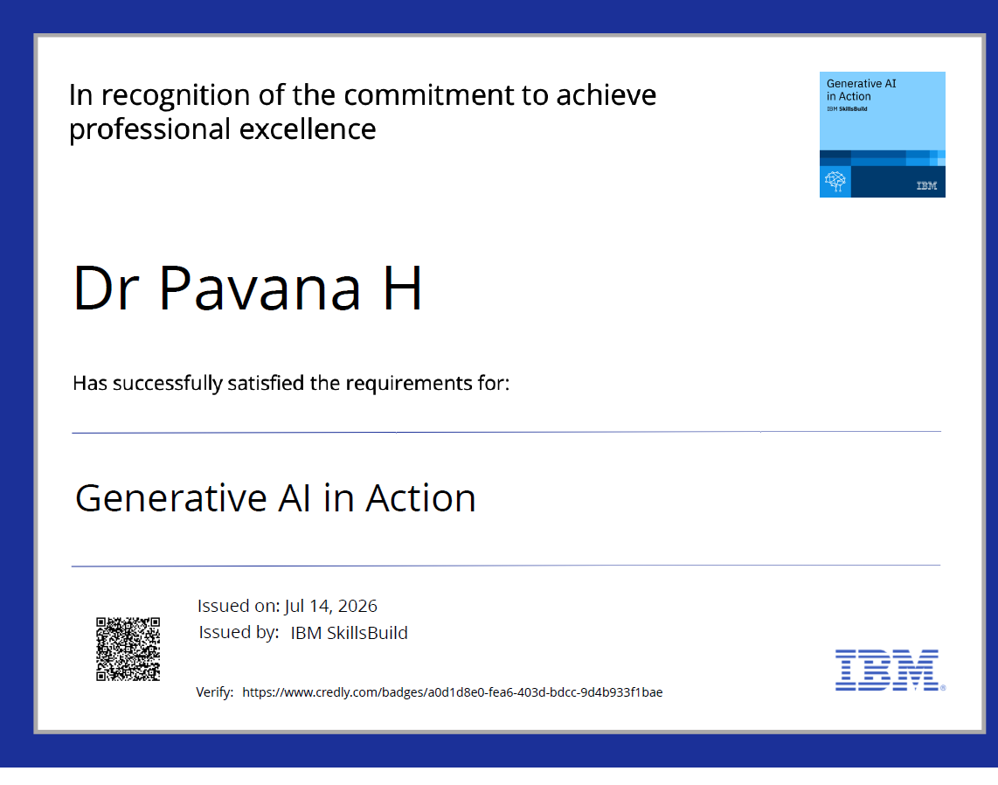
Certificates Earned:
Please add your credly certificate

Slide 15
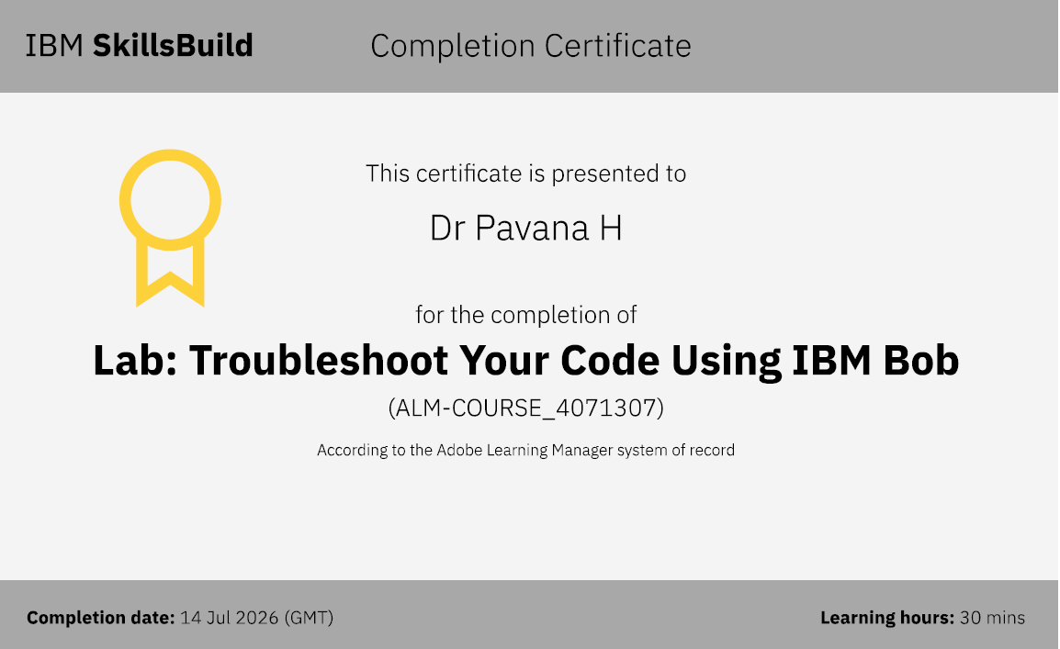
Certificates Earned:​
Add your IBM BOB Certificate

Slide 16


